Slide 1
Analyzing the Impact of Demographic Factors on the occurrence of Post Natal Depression (measured using EPDS scores) in Pregnant Women during COVID-19 Pandemic
Group 13
Nikhil Chowdary Gali, Poorva Reddy Vanga, Puja Darshana Mishra, Ramya Keerthi Majji, Sushruthi Panakanti

Slide 2
Introduction
Amidst the COVID-19 pandemic, pregnant women face amplified mental health challenges, as evidenced by heightened stress, fear, anxiety, and depression (Arzamani et al., 2022). The pandemic's collateral impacts, such as social distancing measures, exacerbate mental health concerns (Harville et al., 2023).
The pandemic's collateral impacts, such as social distancing measures, exacerbate mental health concerns (Harville et al., 2023).
The study uses data from the Pregnancy during the COVID-19 Pandemic project to examine how perceived threats from the pandemic impact mental health outcomes.
The research focuses on quantifiable indicators such as EPDS and PROMIS scores.
Insights from this study aim to inform interventions and support strategies for pregnant women facing heightened mental health challenges during the pandemic.

Slide 3
Research Question and Hypothesis
Is there a correlation between demographic factors (age, household income, maternal education) and postnatal depression (using EPDS scores) in pregnant women during the COVID-19 pandemic?
Null Hypothesis (H0): There is no correlation between demographic factors (age, household income, maternal education) and postnatal depression (EPDS scores) in pregnant women during the COVID-19 pandemic.
Alternative Hypothesis (H1): There is a correlation between demographic factors (age, household income, maternal education) and postnatal depression (EPDS scores) in pregnant women during the COVID-19 pandemic.

Slide 4
Dataset
This Dataset aimed to understand the impact of COVID-19-related stresses on pregnant individuals and their infants and collected survey-based data across Canada as part of the Pregnancy during the COVID-19 Pandemic (PdP) project.
The dataset: Mental health in the pregnancy during the COVID-19 encompasses a range of variables including demographic details, obstetric information, perceived threat levels during the COVID-19 pandemic, and mental health outcomes such as EPDS scores for postnatal depression and PROMIS anxiety scores.
These variables provide a comprehensive view for analysis. The types of variables include categorical, numerical, and ordinal, with distributions varying depending on the specific variable.
The link to the dataset : https://www.kaggle.com/datasets/yeganehbavafa/mental-health-in-the-pregnancy-during-the-covid-19/data

Slide 5
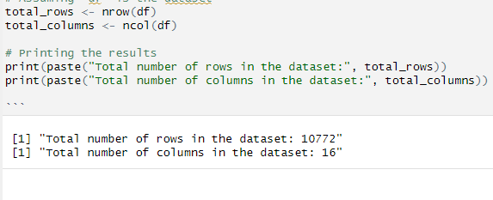
Variables and Data Preparation
NUMERICAL VARIABLES | CATEGORICAL VARIABLES
Maternal age EPDS Scores PROMIS Anxiety Scores | Maternal Education Household Incomes NICU stay Mode of Delivery
Loaded the dataset from "Pregnancy During the COVID-19 Pandemic.csv".
Checked for total rows and columns in the dataset : 10772 Rows and 16 columns.

Slide 6
Variables Description
Maternal Age- This was a continuous numerical column with the ages of the pregnant women.
Household Income- This was a categorical column with ordinal data, which described the household income of the women, there were 9 categorical ranges in this column, the least being 'Less than $20,000 and the highest being '$2,00,000+'.
Maternal Education- This was a categorical column with ordinal data, which described the Education qualification level of the mothers, it had 6 categories, the lowest being "Less than high school' , and the highest being 'Doctoral degree'
NICU stay: This was a categorical column which described if there was a NICU stay or not in each case, indicated with either 'yes' or 'no'.
Mode of Delivery: This was a categorical column, which described if the delivery method was vaginal or C- section.
EPDS Scores- This column was numerical data which indicated the Edinburg Post Natal depression scores, that ranged from 1 to 30.

Slide 7
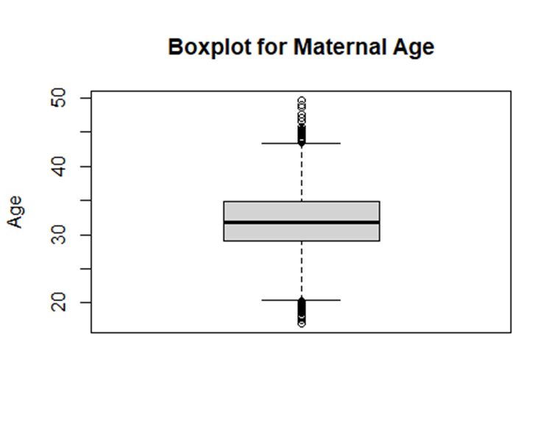
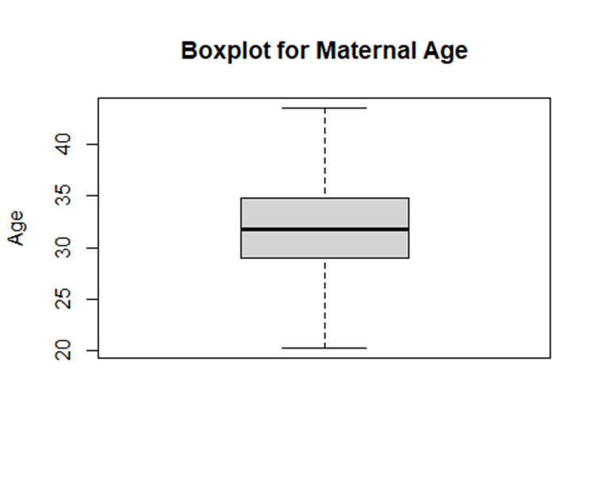
Data Preparation (Contd..)
Checked for null values in the 'Maternal Age' column.
Replaced null values in 'Maternal Age' with the median.
Capped outliers in the 'Maternal Age' column using the interquartile range method (IQR) method.
Visualized the age column before and after treating outliers.
Categorized the ages by dividing the range of ages into 5 sets- 20-24, 25-29, 30-34, 35-39, 40-44.

Slide 8
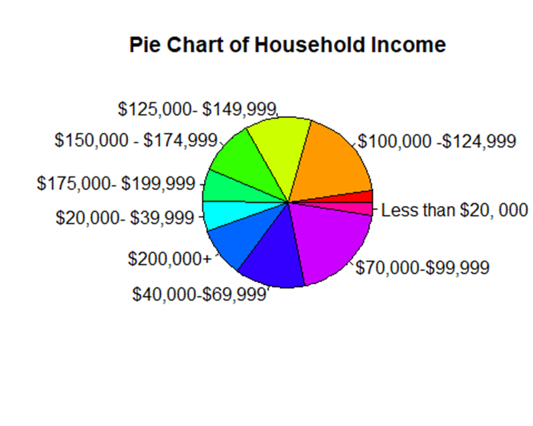
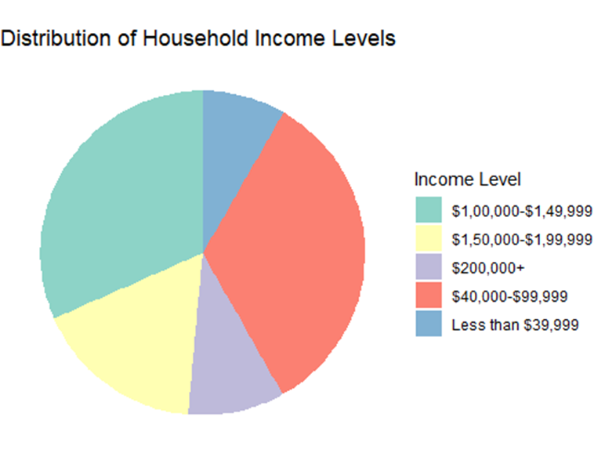
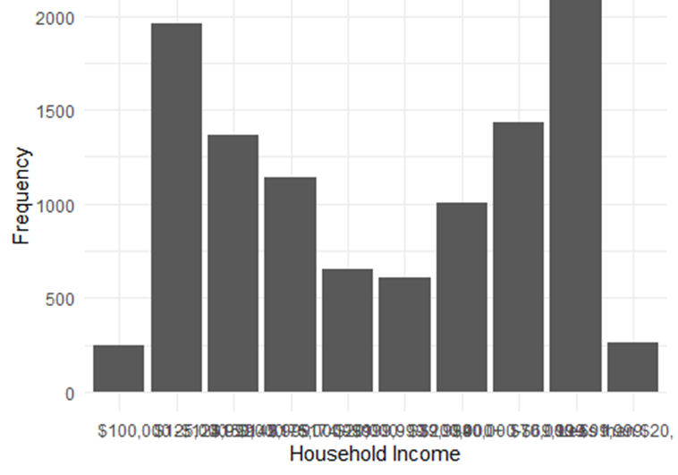
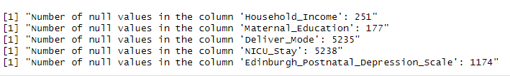
Data Preparation (Contd..)
Handled Null values and empty strings in Maternal Education, Household Income column by using Random sampling.
Visualized the distribution of maternal education levels and household income levels after recategorization.

Slide 9
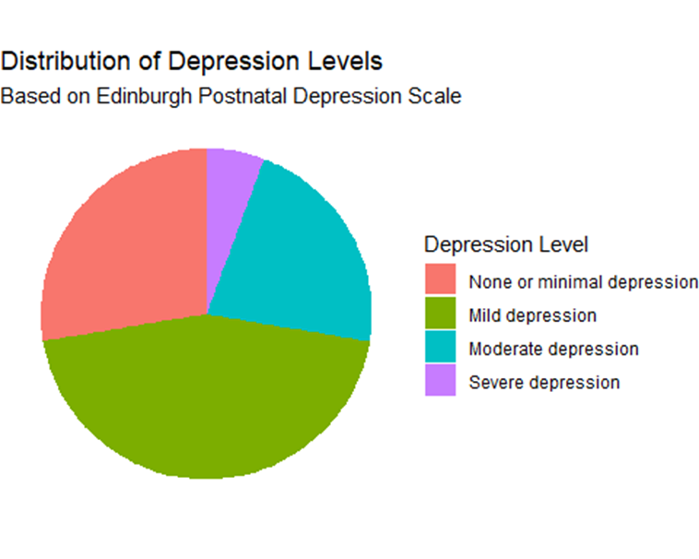
Edinburgh Postnatal Depression Scale (EPDS)
Cleaned EPDS data by replacing empty strings and Null values by using random sampling method.
Recategorized EPDS scores into concise levels making it into categorical data from Numerical data.
Visualized the distribution of depression levels using a pie chart.
Scores from 0 to 6 are labeled as "None or minimal depression".
Scores from 7 to 13 are labeled as "Mild depression".
Scores from 14 to 19 are labeled as "Moderate depression".
Scores from 20 to 30 are labeled as "Severe depression".

Slide 10
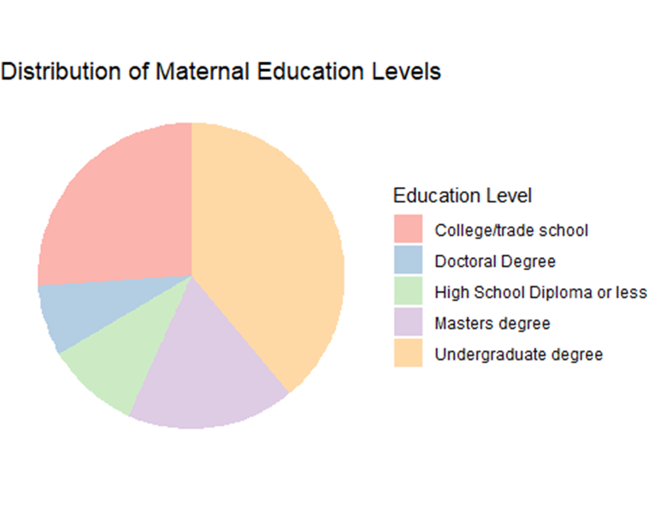
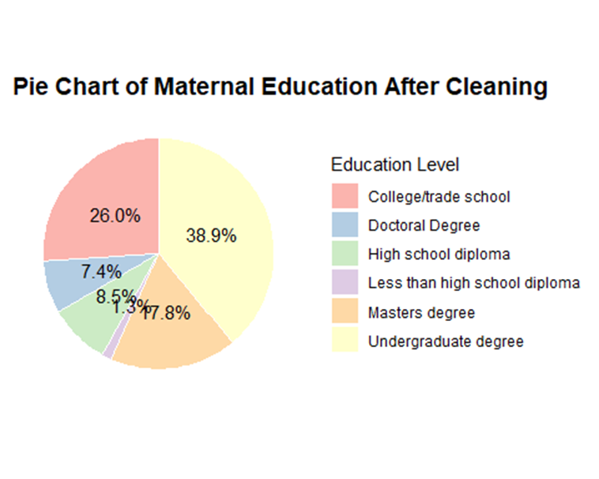
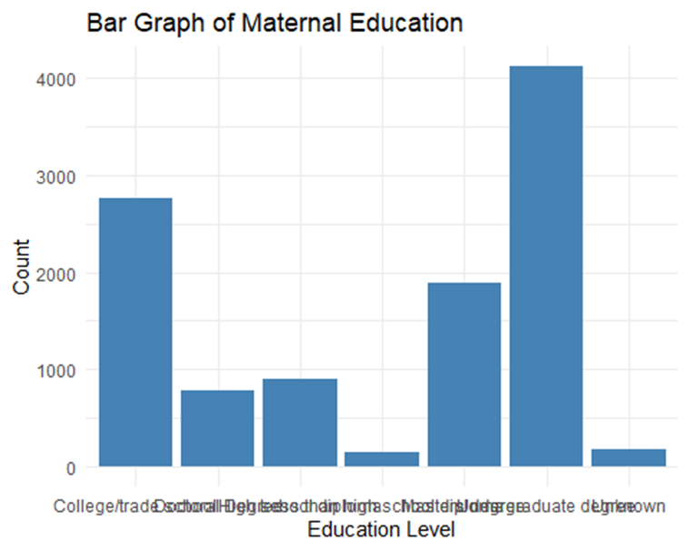
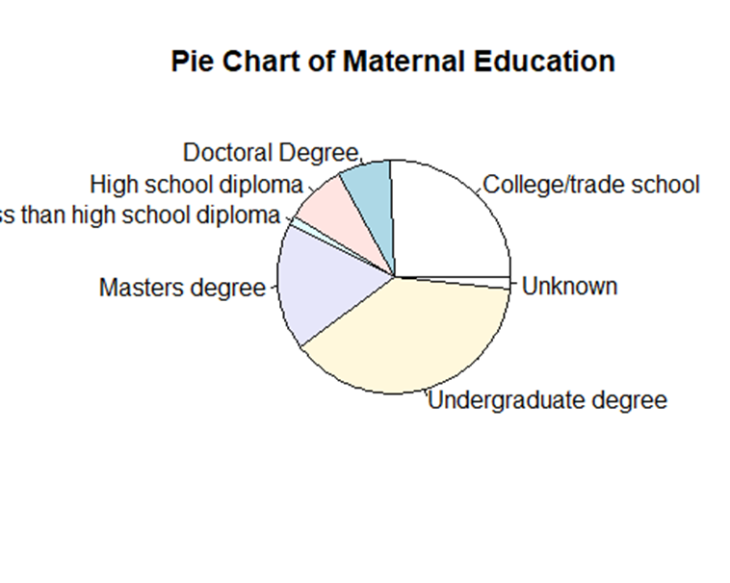
Visualizations
Creating visualizations to understand the distribution of maternal education levels using bar graphs and pie charts.
Visualizing the distribution of household income levels using bar graphs and pie charts.
Visualizing the distribution of depression levels using a pie chart.

Slide 11
Exploratory Data Analysis

Slide 12
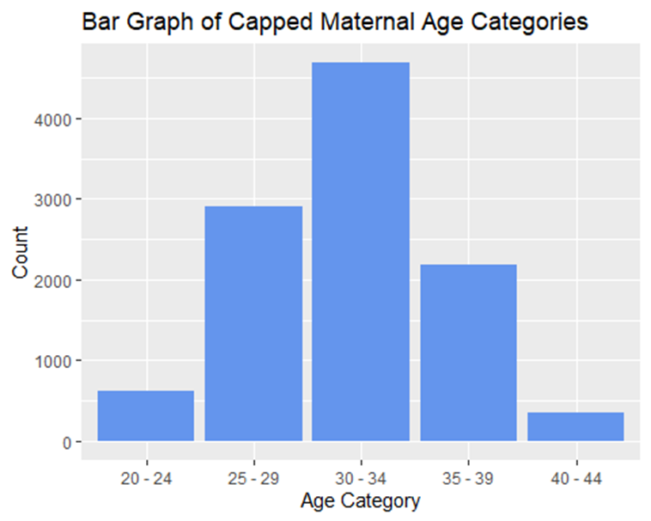
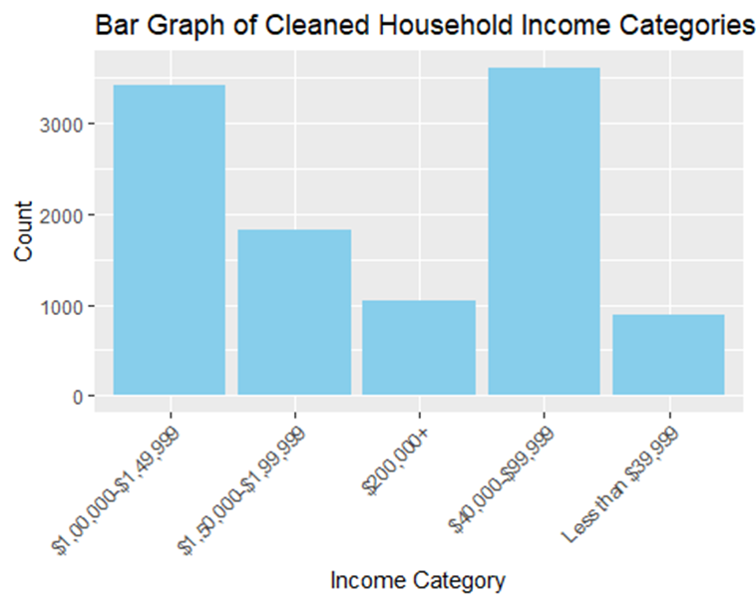
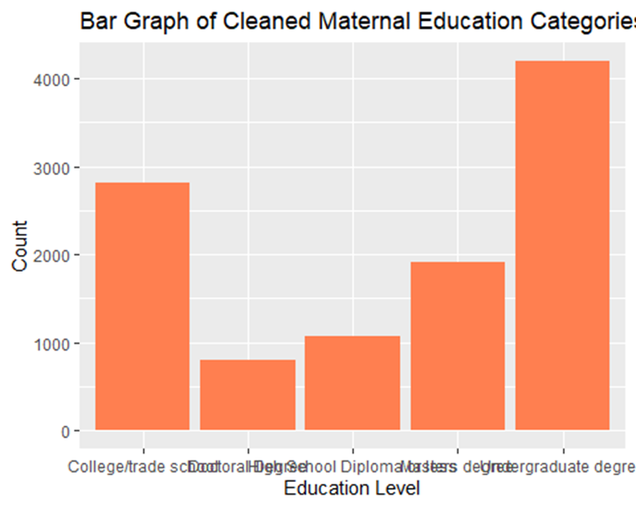
Distribution of Categorical Variables
Bar graphs depicting the distribution of categorical variables:
Capped Maternal Age categories
Cleaned Household Income categories
Cleaned Maternal Education categories

Slide 13
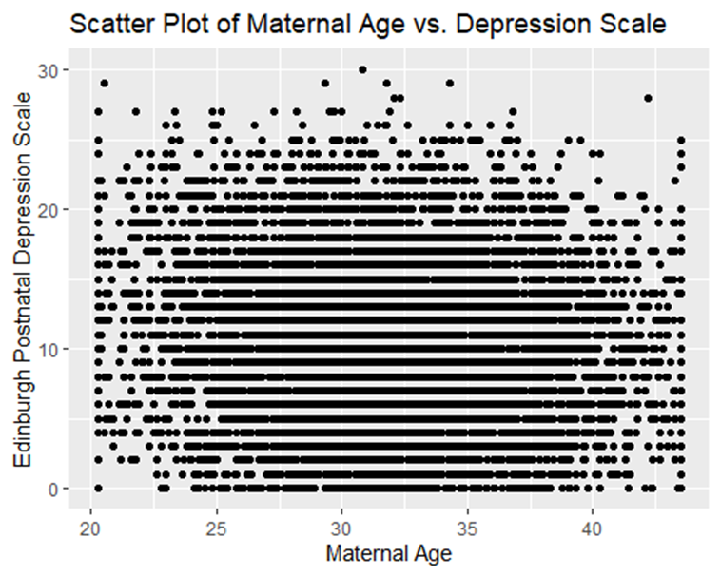
Scatter Plot of Maternal Age vs. Depression Scale
Scatter plot showing a strong linear relationship between Maternal Age and Edinburgh Postnatal Depression Scale scores.

Slide 14
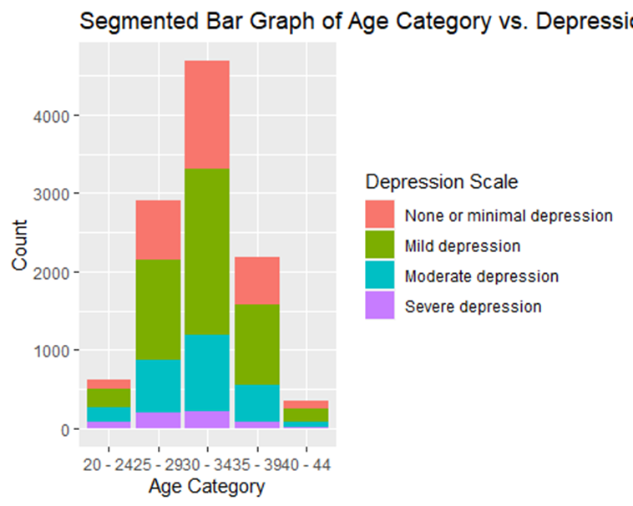
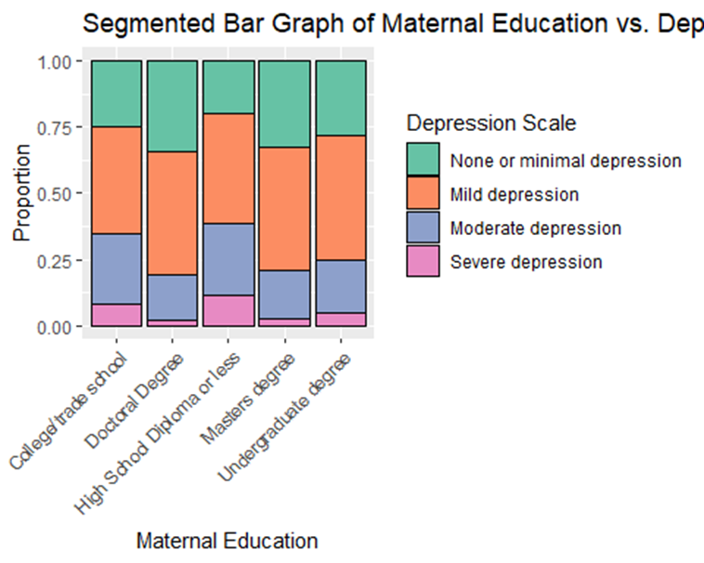
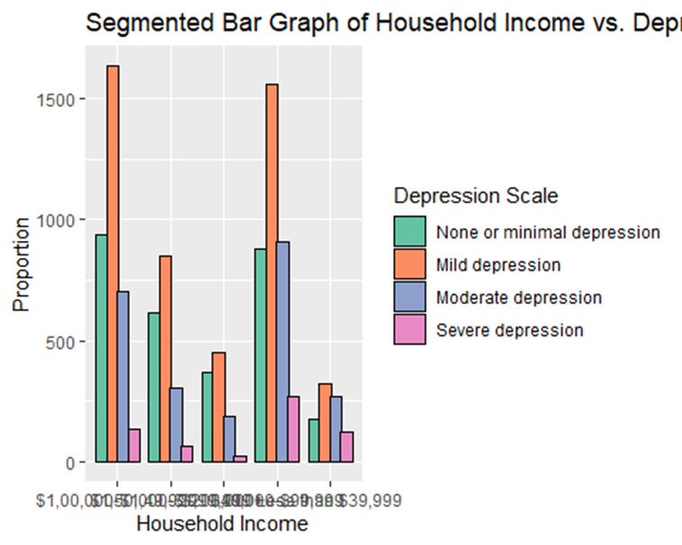
Segmental Bar Graphs
Segmented bar graphs illustrating the relationship between various categorical variables and Depression Scale scores:
Age Category vs. Depression Scale
Household Income vs. Depression Scale
Maternal Education vs. Depression Scale

Slide 15
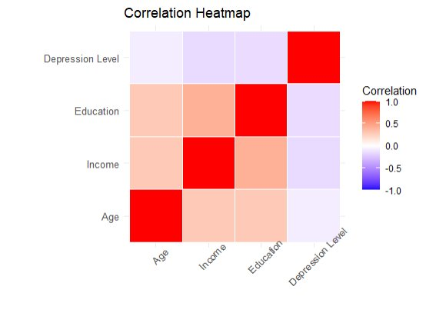
Correlation Analysis
We created a correlation heatmap to visualize the relationship among the independent variables, and between the independent and dependent variables.
We computed correlation matrix and analyzed the correlation matric by drawing up a correlation analysis among the variables.
We found that there is strong correlation among the independent variables, and between the independent and dependent variables.
The independent variables of Income and education showed strong positive correlation with the independent variables, age shows a weak positive correlation. We will see if they are significant or not in our statistical tests.

Slide 16
Statistical Testing

Slide 17
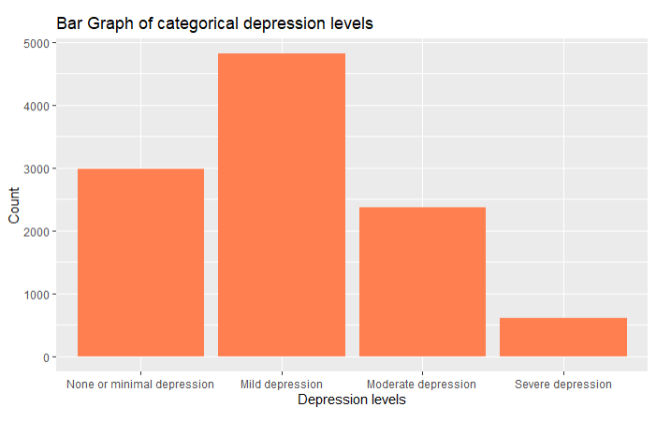
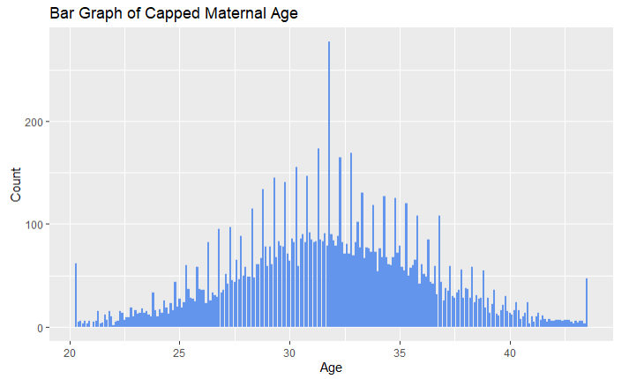
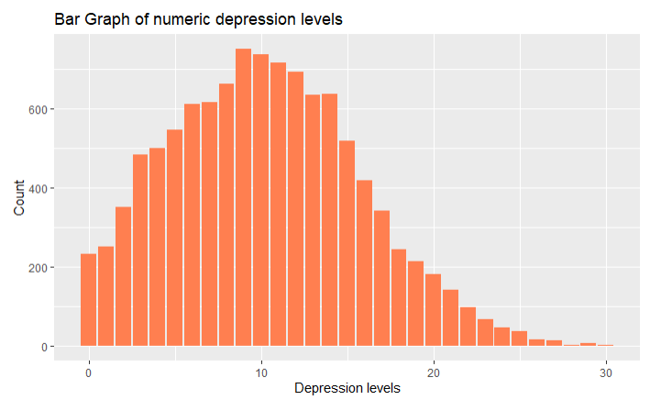
Checking for Normality
Checked for normality of data using Histograms as our variables are categorical in nature.
No normality tests performed as normality of categorical data can be assessed only by data visualizations.
Inference: We observed that among our Independent Variables- the Maternal age was normally distributed, but the Household Income and Maternal Education Levels were not normally distributed.
We also observed that our Dependent variable- Post Natal depression levels could be said to be normally distributed.
We went ahead and checked the normality for Age and Post Natal depression level scores for the columns which still had numerical data intact.
We observed that the numerical continuous data for Maternal Age and EPDS scores was normally distributed.

Slide 18
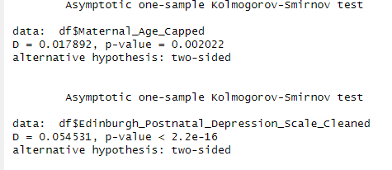
Checking for Normality (Contd..)
As we checked for the normality for our previously numerical columns, we conducted a normality test for these columns
Kolmogorov-Smirnov Test- This test compares the empirical distribution of the data with the expected distribution if the data were normal. It is more suitable for larger datasets.
We first thought of doing Shapiro- Wilk test, but as our data set was larger consisting of 10,000 rows, we went ahead with Kolmogorov-Smirnov Test.
As our p values were very small and less than 0.05, we concluded that both of these columns have normally distributed data.

Slide 19
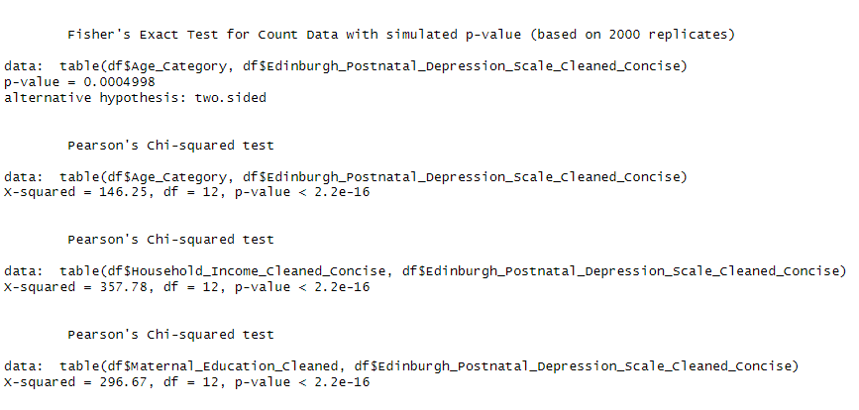
Pearson's Chi square tests and Fisher's test
We performed Pearson's Chi square tests for our categorical data to check for co-relation.
The columns we performed these tests were- Age category, Household Income, Maternal Education level, Post Natal Depression levels
Based on the results, we could reject null hypothesis as the p values were very low(0.00049), there seems to be a co-relation between the demographic factors of age, income and education and post-natal depression.

Slide 20
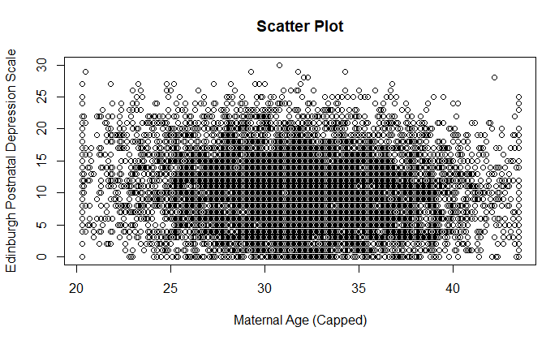
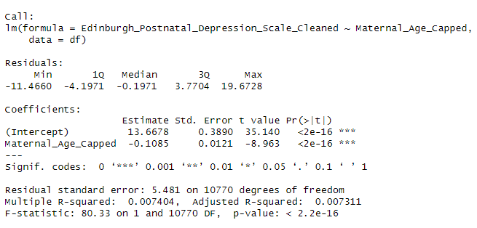
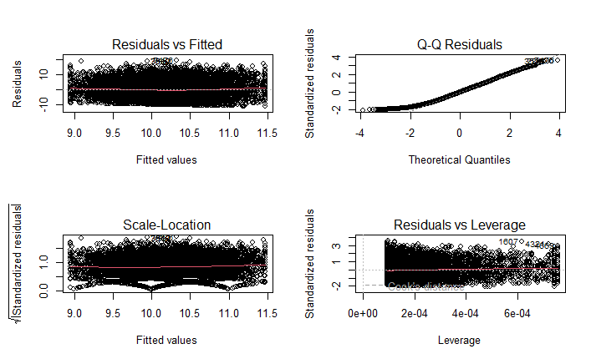
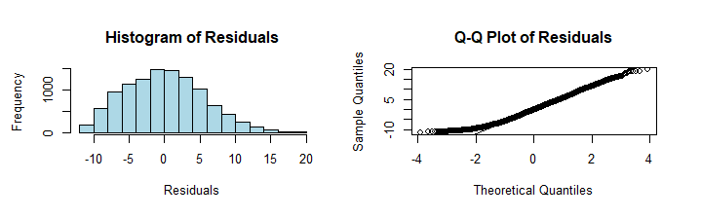
2. Simple linear Regression (Age and EPDS scores)
The assumptions in linear regression are linearity, constant variability, independent observations, and approximate normality of residuals. After all these assumptions were satisfied, we performed the regression test
Our Output showed that there is High correlation between the age and depression levels as the P value was <2e-16.
As the R square was very small, we understood that age is not the only influencing factor for depression levels.

Slide 21
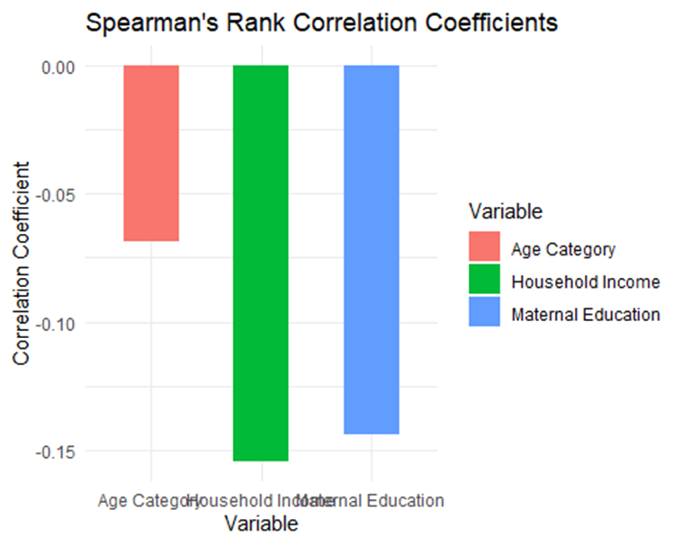
3. Spearman's Rank Correlation
Analyzed correlation between each predictor variable and EPDS categories. We calculated correlation coefficients and p-values for the following.
Age Category vs. EPDS Categories
Household Income vs. EPDS Categories
Maternal Education vs. EPDS Categories

Slide 22
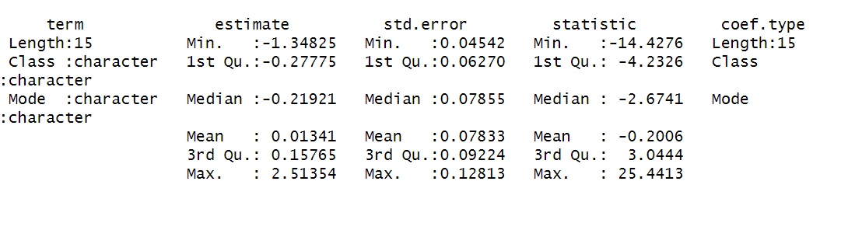
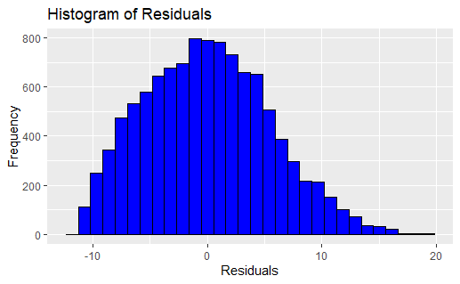
4. Ordinal Logistic Regression
Ordinal logistic regression requires an ordered categorical dependent variable, predictors that can be continuous or categorical, and assumptions like proportional odds and absence of multicollinearity.
Conducted an ordinal logistic regression analysis to predict EPDS score based on our independent variables- maternal age, education and household income.
The coefficient estimates and the confidence intervals plot visualizes the uncertainty associated with each coefficient estimate, with wider intervals indicating greater uncertainty.
The histogram of residuals indicates the distribution of errors in model predictions.

Slide 23
Findings for Chi square tests and Fisher's Exact test
Fisher's Exact Test for Count Data (with simulated p-value) - Maternal Age vs. EPDS Category:
The p-value obtained from the Fisher's Exact Test is 0.0004998, indicating that there is strong evidence to reject the null hypothesis. This suggests that there is a significant association between Maternal Age and EPDS Category at the 0.05 significance level.
Pearson's Chi-squared Test – Age Category vs. EPDS Category:
The p-value obtained is <2.2e-16 (extremely small), indicating strong evidence to reject null hypothesis. This suggests that there is statistically significant association between Age category and EPDS depression levels.
Pearson's Chi-squared Test - Household Income vs. EPDS Category:
The p-value obtained from the Chi-squared Test is < 2.2e-16 (extremely small), indicating strong evidence to reject the null hypothesis. This suggests that there is a significant association between Household Income and EPDS Category at the 0.05 significance level.
Pearson's Chi-squared Test - Maternal Education vs. EPDS Category:
The p-value obtained from the Chi-squared Test is < 2.2e-16 (extremely small), indicating strong evidence to reject the null hypothesis. This suggests that there is a significant association between Maternal Education and EPDS Category at the 0.05 significance level.

Slide 24
Findings for Simple Linear Regression
The F- statistic of 80.33 with a p-value less than 2.2e-16 indicates that there is strong statistical significance between both the columns, the Maternal age and the EPDS Scores.
The residual stand. Error is 5.481 which represent the average amount that observed EPDS scores deviate from predicted values.
The R- squared value is very low at 0.007404, it should also be factored that, it is because only a single independent column was checked against the dependent column. The more the independent variables increase, the R- squared value increases.

Slide 25
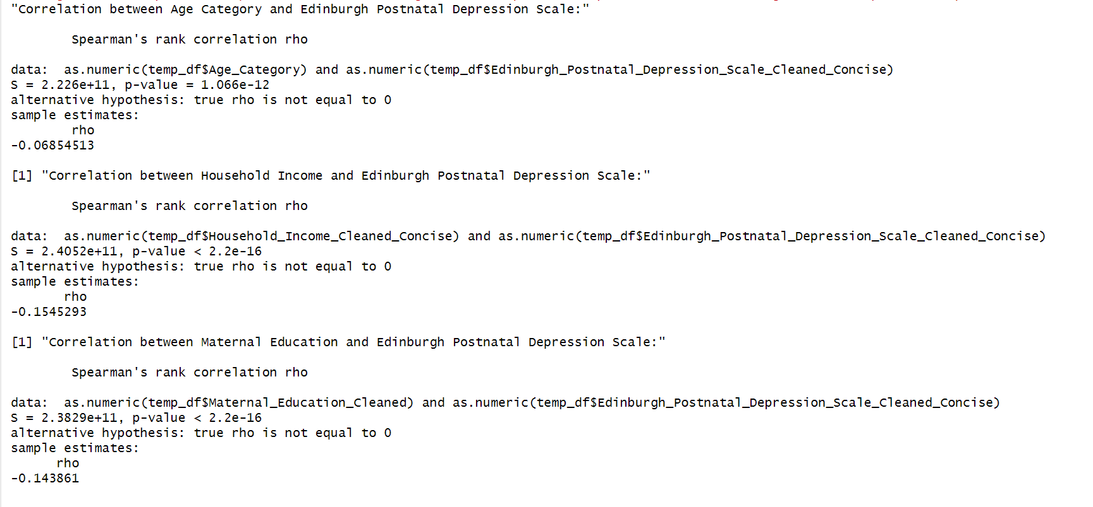
Findings for Spearman's Rank Test
Correlation between Age Category and EPDS:
Spearman's rho is approximately -0.0685 and p- value is approximately 1.066e-12 indicating strong evidence against null hypothesis.
This suggests a weak negative correlation between age category and EPDS scores, meaning that older individuals tend to have slightly lower EPDS scores compared to younger individuals.
Correlation between Household Income and EPDS:
Spearman's rho is approximately -0.1545 and p-value is < 2.2e-16, indicating strong evidence against the null hypothesis.
This indicates a moderate negative correlation between household income and EPDS scores, suggesting that higher household income is associated with lower EPDS scores.
Correlation between Maternal Education and EPDS:
Spearman's rho is approximately -0.143 and p-value is < 2.2e-16, indicating strong evidence against the null hypothesis.
This indicates a moderate negative correlation between maternal income and EPDS scores, suggesting that higher education is associated with lower EPDS scores.

Slide 26
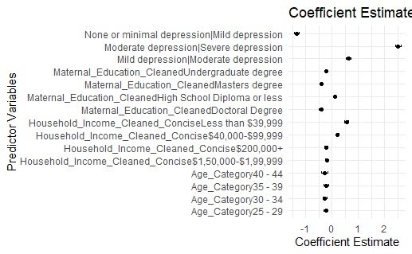
Findings for Ordinal logistic regression
our
The mean estimated coefficient across all predictors is approximately 0.013, indicating a small overall effect on EPDS scores.
The minimum statistic value is approximately -14.4276, and the maximum is approximately 25.4413.
These values are associated with tests of the null hypothesis that the coefficient is equal to zero. Larger absolute values indicate stronger evidence against the null hypothesis.

Slide 27
Conclusion- Hypothesis Testing
Through the four statistical tests we did, the research found significant associations between the demographic factors and EPDS categories. Specifically, the results indicated strong evidence to reject the null hypothesis, suggesting that maternal age, household income, and maternal education levels are significantly associated with the levels of postnatal depression experienced by pregnant women during the COVID- 19 pandemic.
Insights obtained from this research can shape targeted interventions and support strategies customized for distinct demographic groups. The overarching goal is to enhance mental health outcomes for pregnant women at risk of postnatal depression

Slide 28
Limitations
As the data was incomplete for some factors like NICU stay and mode of delivery, we could not include them in our study, adding them would have added depth and more meaning to our study.
Although the correlation analysis revealed connections among the variables, it does not establish causation.
The adjusted R square value in our linear regression is very small, which states that there are more factors that are affecting the depression levels, other than the ones we have considered.
Fisher's Exact Test: This test may have limitations when dealing with large sample sizes(McDonald, 2014).

Slide 29
References
Arzamani, N., Soraya, S., Hadi, F., Nooraeen, S., & Saeidi, M. (2022). The COVID-19 pandemic and mental health in pregnant women: A review article. Frontiers in Psychiatry, 13, 949239. https://doi.org/10.3389/fpsyt.2022.949239
Harville, E. W., Wood, M. E., & Sutton, E. F. (2023). Social distancing and mental health among pregnant women during the coronavirus pandemic. BMC Women’s Health, 23(1), 189. https://doi.org/10.1186/s12905-023-02335-x
Kaggle. (n.d.). Mental Health in the Pregnancy During the COVID-19. Retrieved from https://www.kaggle.com/datasets/yeganehbavafa/mental-health-in-the-pregnancy-during-the-covid-19
McDonald, J. H., (2014). Handbook of Biological Statistics (Third). Sparky House Publishing.https://www.biostathandbook.com/HandbookBioStatThird.pdf

